Slide 1


Climate data Analysis
Team Members:
Heer Modi [241133107026]
Harsh Panchal [241133107028]
College — Sal College of Engineering

Slide 2

Project Objectives
Problem Statement
Project Overview – Introduction
End Users
Wow Factor in Project
Modelling/Block Diagram/Flow of Project
Result/outcomes
Conclusion
Future Perspective

Slide 3
Problem Statement
Climate datasets are large, heterogeneous, and often inaccessible to non-technical users. Existing tools lack interactive visualization, integrated trend detection, and an intuitive interface for domain experts.
Needs
Centralized platform to process raw climate files
Clear visual summaries and correlation detection
Exportable results for downstream analysis

Slide 4
Project Overview – Introduction
The Climate Data Analyzer is a Python Streamlit application that ingests CSVs, automatically preprocesses data, and produces interactive visualizations and trend analyses for multi-country and multi-indicator climate studies.
Upload & Clean
Automated missing value handling, type conversion , and standardization.
Explore
Interactive charts: time series, bar/pie charts, and heatmaps.
Export
Filtered datasets can be downloaded for further research and reporting.

Slide 5
End Users
Climate Researchers
Deep-dive analyses to support papers and models.
Government & Policy Makers
Evidence-based insights to inform policy and planning.
NGOs
Assess impacts and prioritize mitigation efforts.
Students & Academics
Accessible tool for coursework and capstone research.
Data Analysts
Rapid prototyping and exploratory analysis of environmental trends.

Slide 6
Wow Factors in Project
Interactive Dashboard
Streamlit UI with responsive filters and dynamic charts.
Real-time Trend Analysis
On-the-fly linear regression and slope interpretation.
Multi-indicator Support
Compare countries, indicators, and timespans simultaneously.
One-click Exports
Download filtered CSVs for reproducible workflows.
Modular Design
Extendable analytics and visualization modules for
future work.

Slide 7
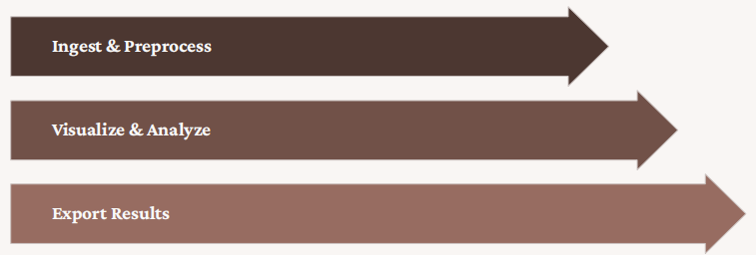
Flow of Project

Slide 8
Technology Stack
Python
Core language for data processing and modeling.
Streamlit
Rapid web UI for interactive exploration.
Plotly
Interactive visualization with zoom and hover.
Matplotlib
Static visualizations and publication ready plots.
Scikit-learn
Machine learning and statistical analysis.
Seaborn
Statistical data visualization.

Slide 9
✅ INPUT FIELDS (System Inputs)
1️⃣ CSV File Upload
User uploads climate dataset in .csv format
Dataset must contain :Year ,Value , Indicator , Country (optional but recommended)
2️⃣ Indicator Selection (Dropdown)
User selects: All Indicators OR specific indicator (e.g., CO₂ Emissions, Temperature Rise, etc.)
Used for filtering data and trend analysis
3️⃣ Top Countries Slider
User selects number of top countries
Range: 5 to 20
Used for bar chart visualization
4️⃣ Tabs Selection
User can navigate between:
Summary
Charts
Trends
Export

Slide 10
✅ OUTPUT FIELDS (System Outputs)
📊 1️⃣ Summary Tab Output
Dataset statistical summary (Mean, Std, Min, Max) , Column names display , Unique Indicators list
, Unique Countries list , Mean value of each Indicator
📈 2️⃣ Charts Tab Output
• Pie Chart
• Time Series Graph
• Bar Chart
• Correlation Heatmap
📉 3️⃣ Trends Tab Output
• Linear Regression Results , Slope value , R² score
• Scatter Plot with Trend Line
• Indicator-wise Slope Comparison
📥 4️⃣ Export Tab Output
Download filtered dataset as CSV

Slide 11
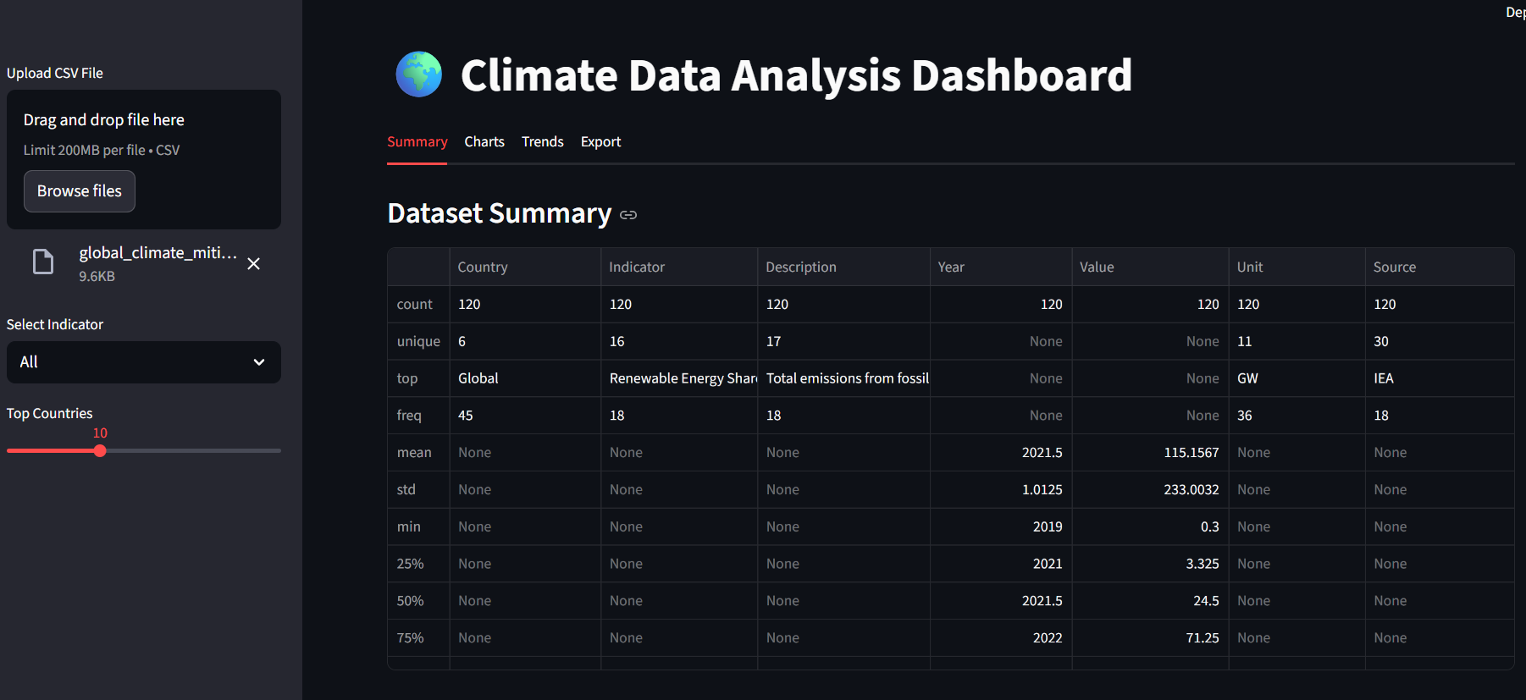
Result/Outcomes Screen-shots
Main Pages:-

Slide 12
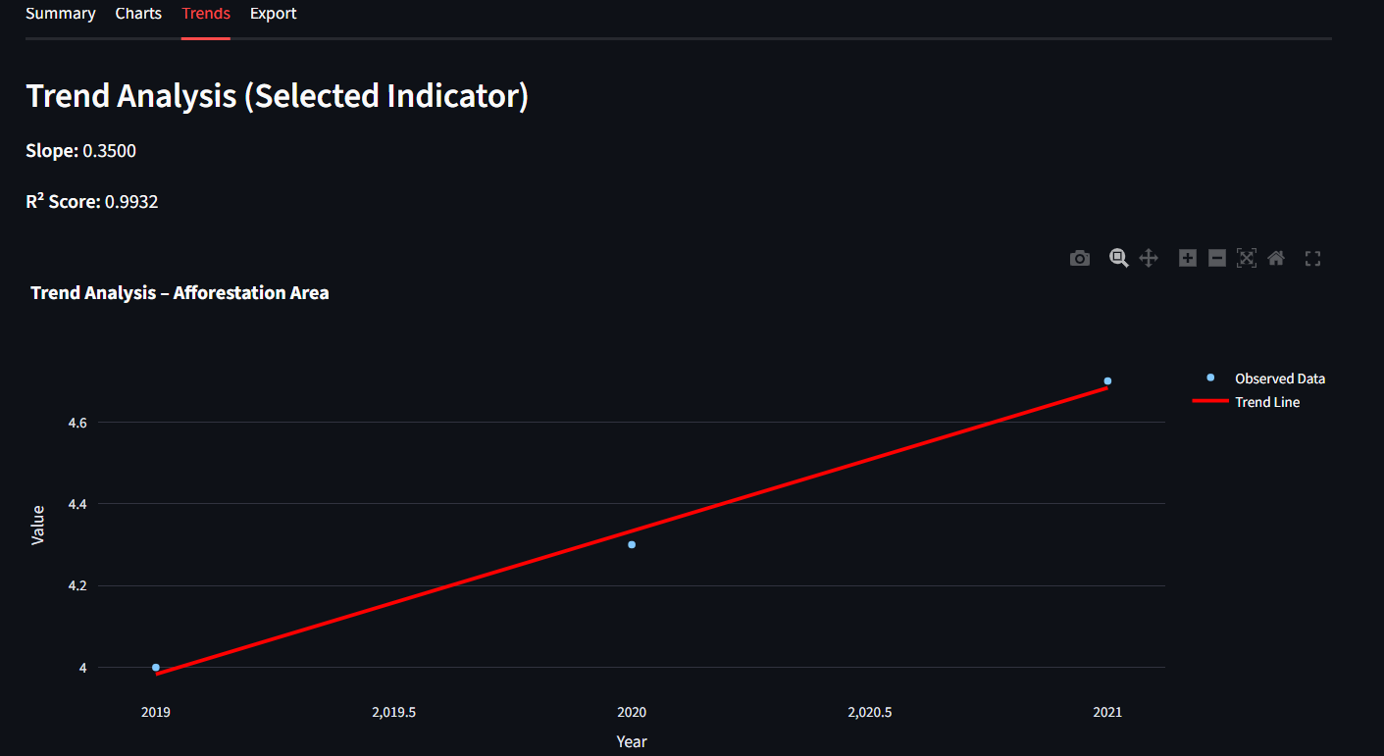
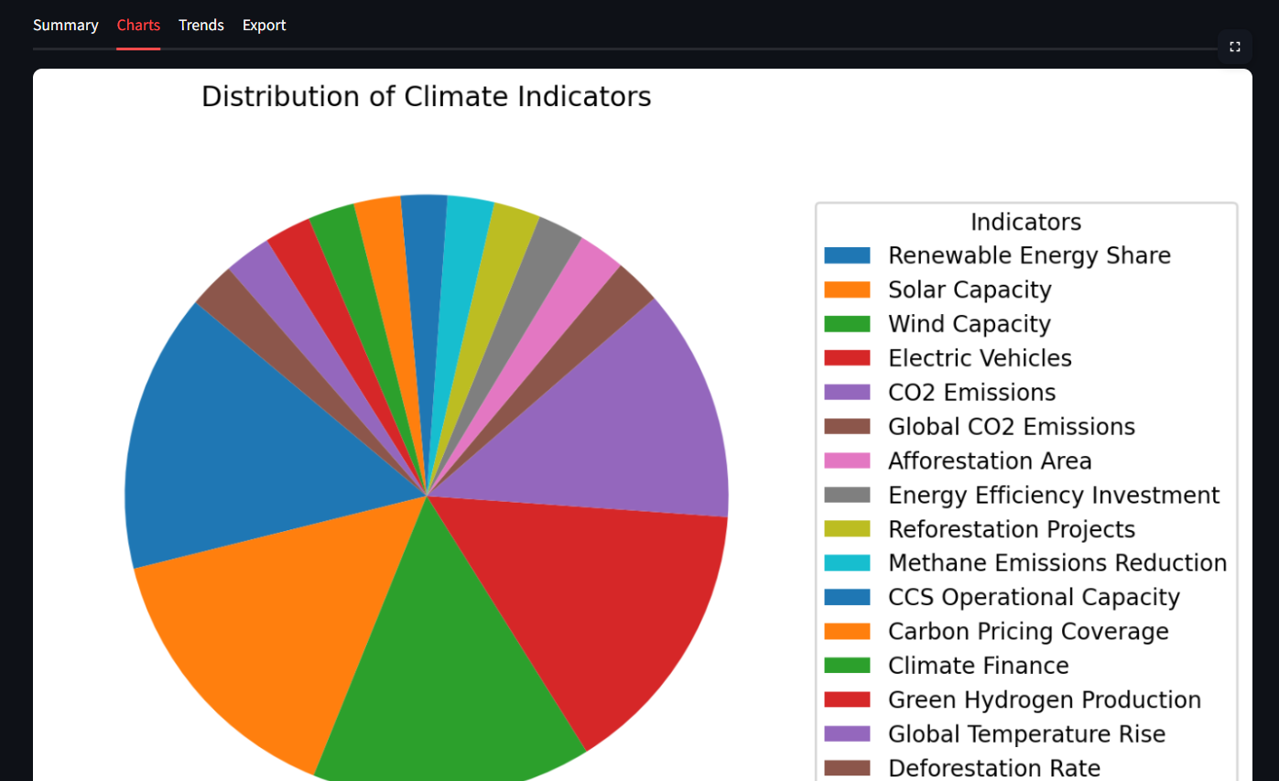
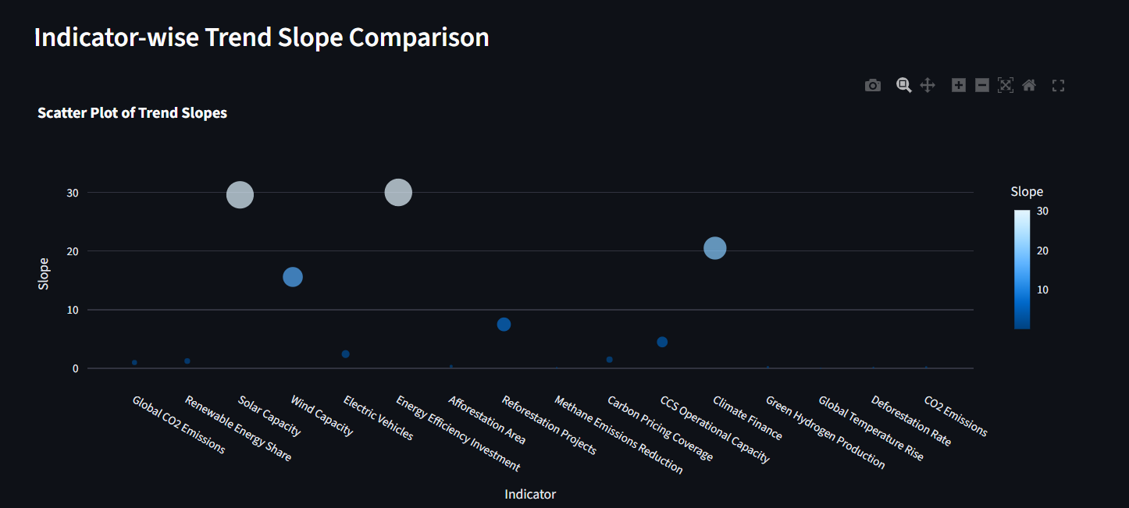

Slide 13
Conclusion
Climate data Analysis bridges raw climate records and actionable insights through a modular Streamlit platform. The project demonstrates practical application of data science, visualization, and scalable design.
1 Short-term
Implement automated data ingestion and scheduled reports.
2 Medium-term
Add forecasting models and ensemble methods for stronger trend estimates.
3 Long-term
Deploy as a multi-user web service with role-based acc

Slide 14
Future Perspective
Short Term:
Improve data preprocessing, add more interactive visualizations, and automate report generation for quick climate analysis.
Mid Term:
Integrate forecasting models and advanced analytics to predict future climate trends and analyze sector-wise impacts.
Long Term:
Deploy the system as a cloud-based, AI-driven decision support platform with real-time data integration and multi-user access for policymakers and researchers.

Slide 15
Thank You
Notes:
Thank You !!

